Slide 1
Java Class
Day 16

Slide 2





Jul
Aug
TOEIC(7/24) 6/6~7/11
TEPS(7/16) 6/29~7/12
TOEIC(8/07) 6/20~7/25
TOEIC(8/21) 7/ 4 ~ 8/ 8
TEPS (8/06) 6/20~7/17
TEPS (8/20) 7/ 4 ~7/31
Big Data Analyst(10/1)
8/29~9/2
ADsP(8.28) 8/1~8/5
www.toeic.co.kr
www.teps.or.kr
www.dataq.or.kr
austin.sogang.ac.kr
austiny.snu.ac.kr

Slide 3
Mon
Tue
Wed
Thu
1. Main
Fri
1. Recap Sub
2. Main
2.
3. Main
3.
4. Main
4.
LUNCH
LUNCH
5. Sub
5. Recap Main
6. Sub
6.
7. Sub
7.
8. Recap, Test
8. Test
Jul
Aug
Java Basic
HTML, CSS, JS
Java Intermediate
Database

Slide 4
Java

Slide 5
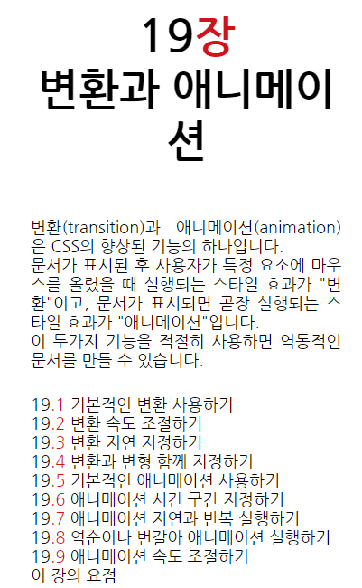
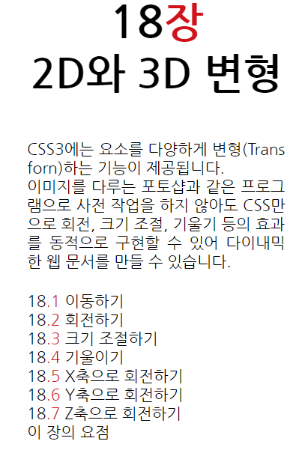
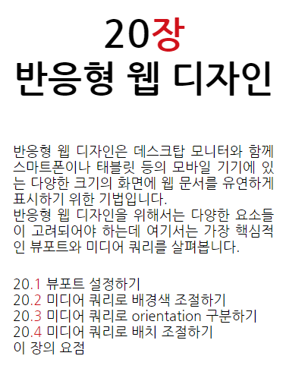
CSS

Slide 7
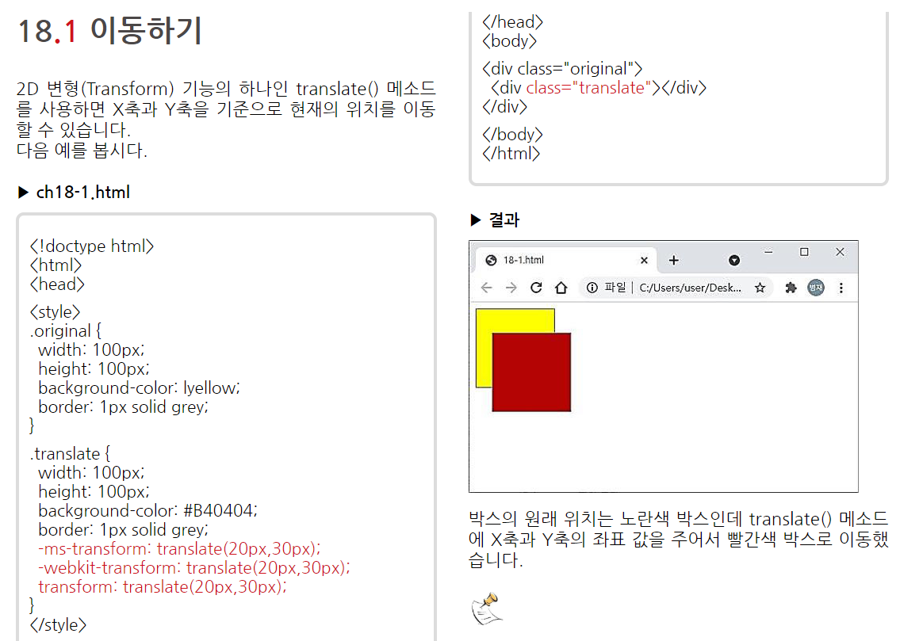

Slide 8
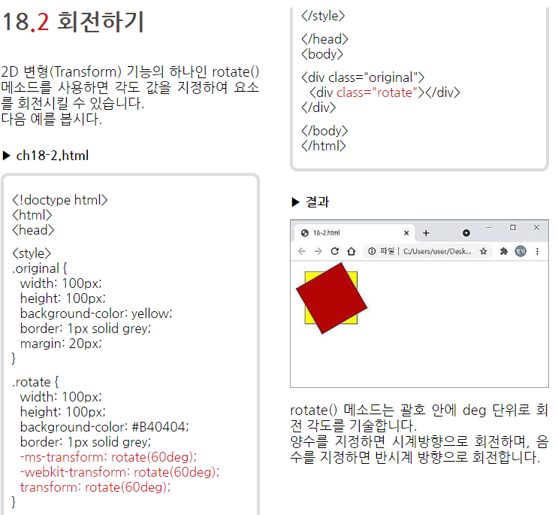

Slide 9
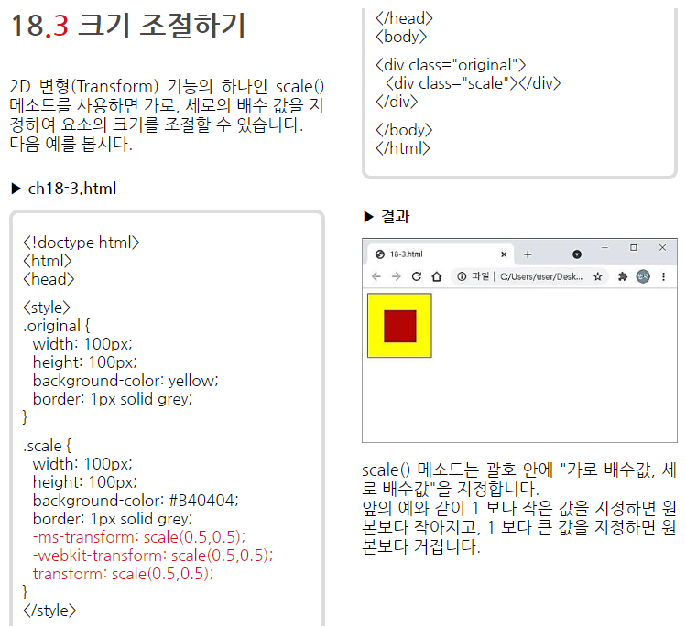

Slide 10
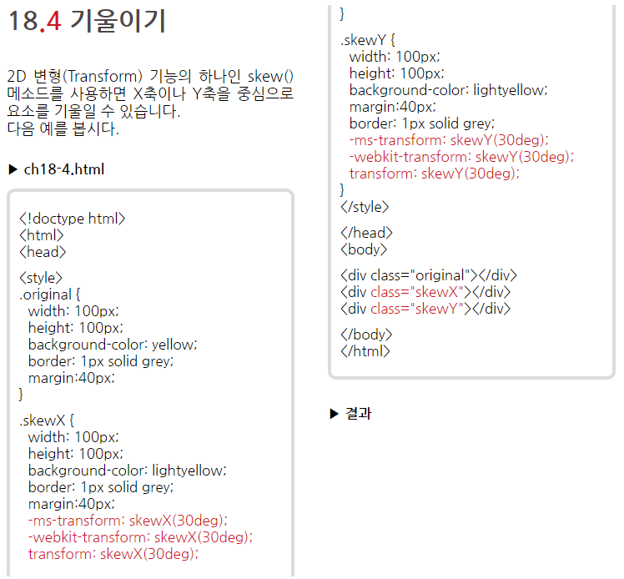


Slide 11
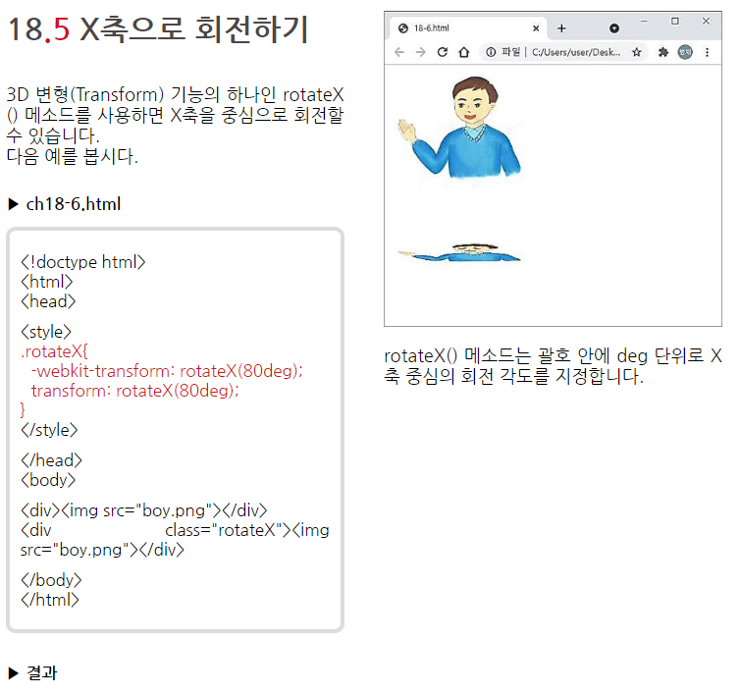

Slide 12
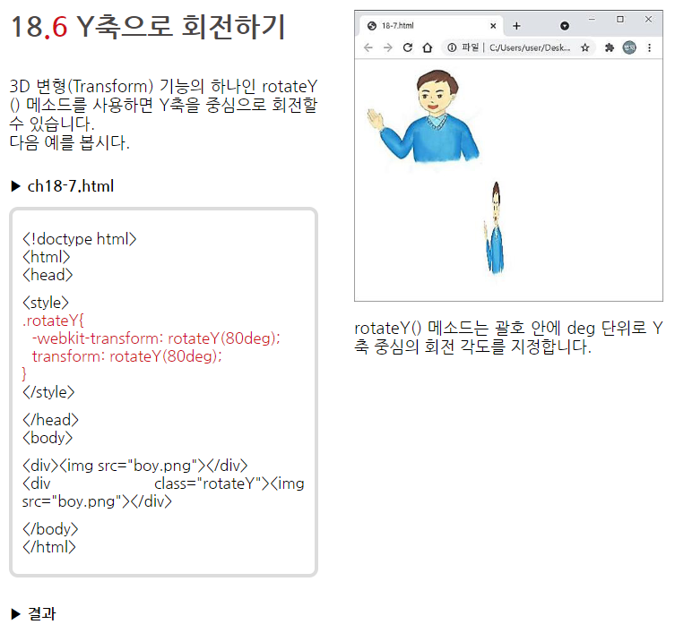

Slide 13
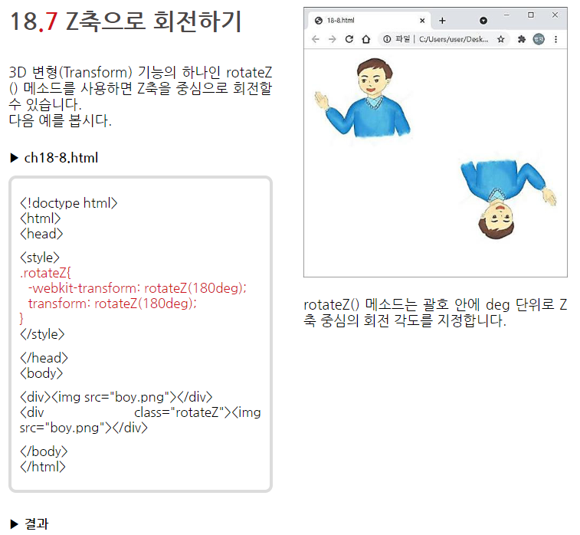

Slide 14
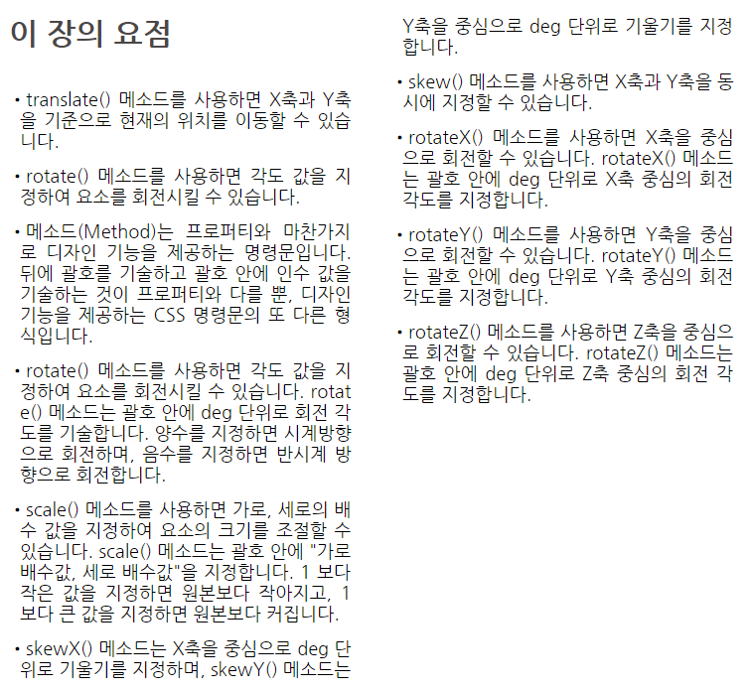

Slide 16
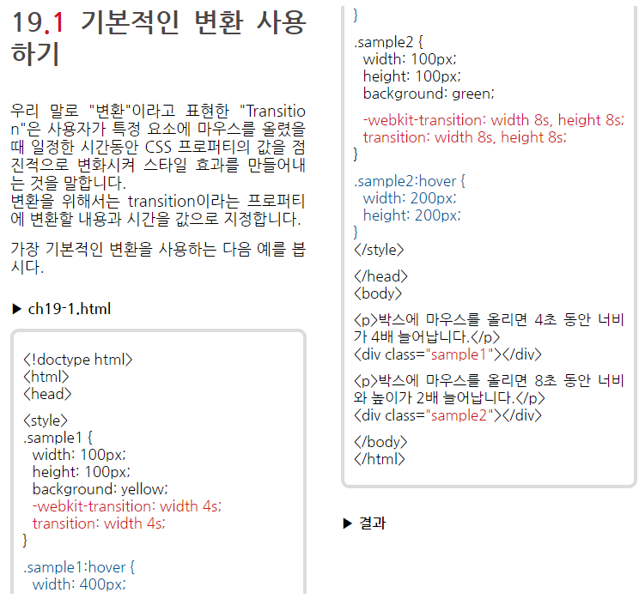
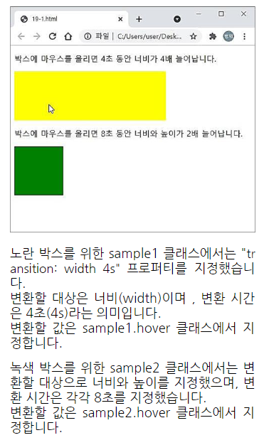

Slide 17
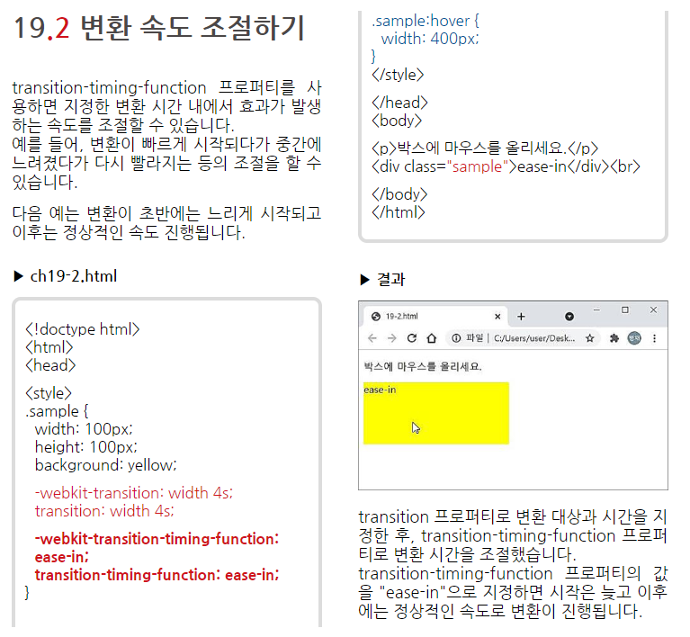
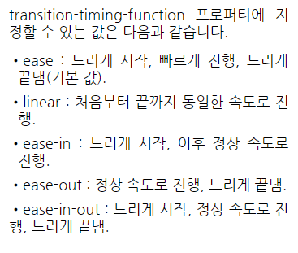

Slide 18
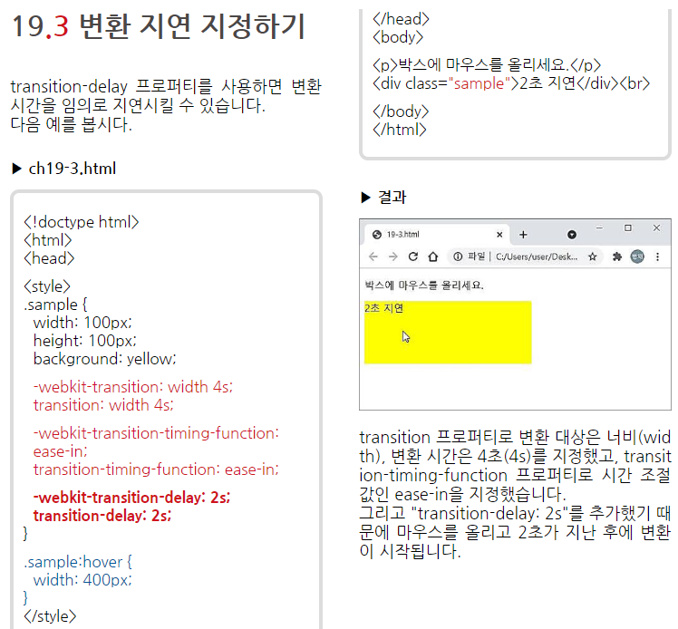

Slide 19
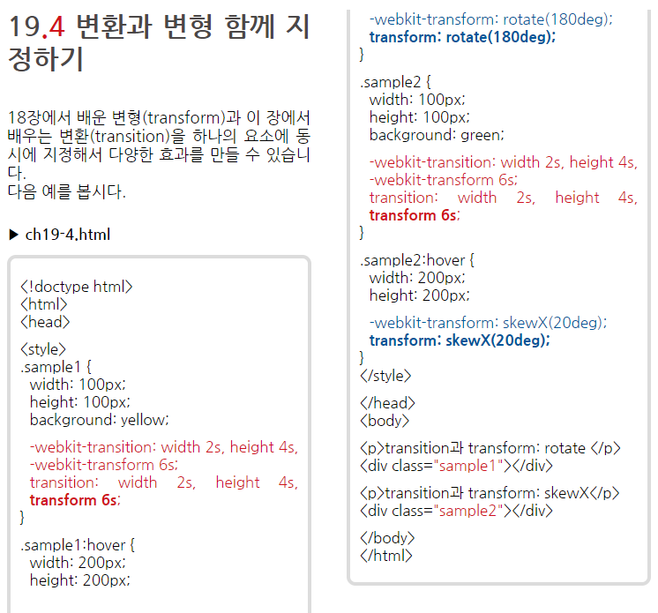
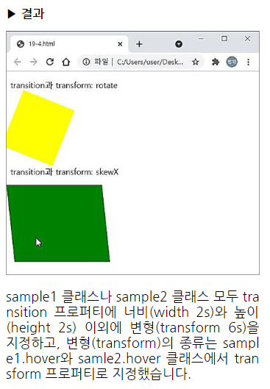

Slide 20
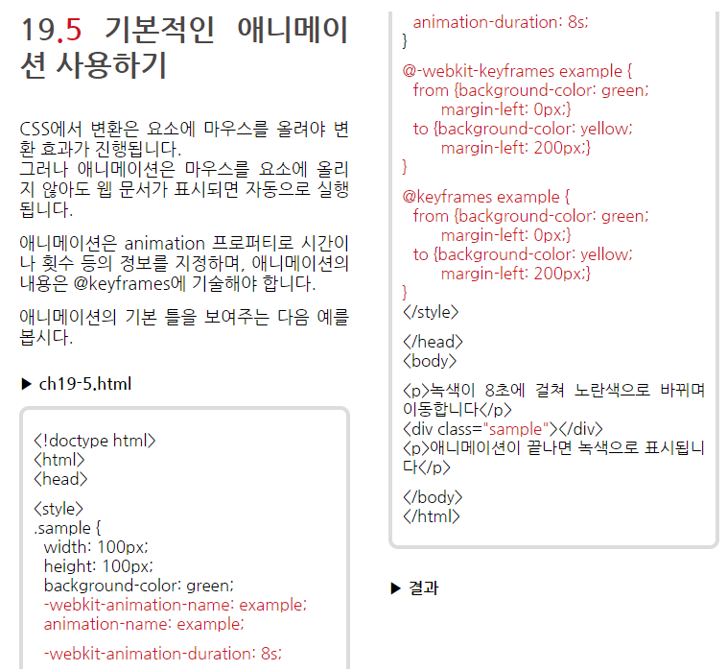
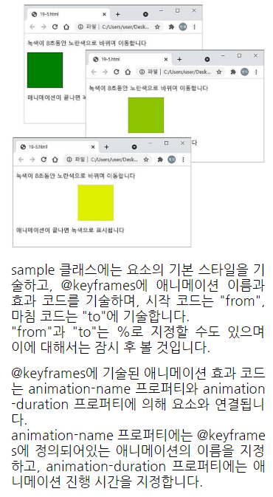

Slide 21
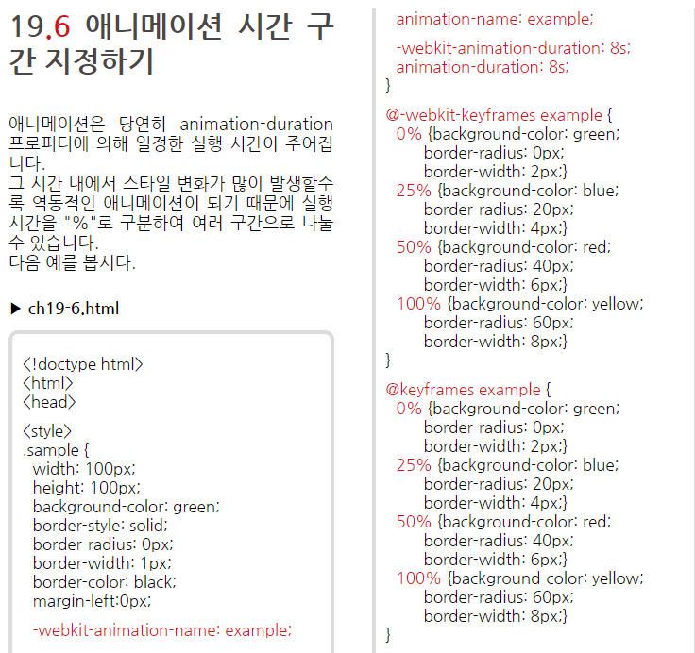
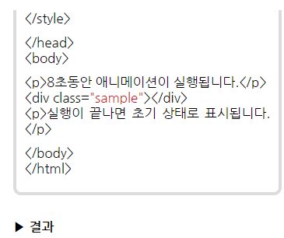
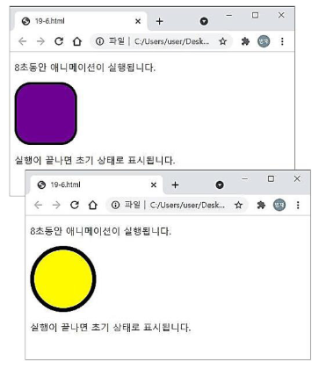

Slide 22
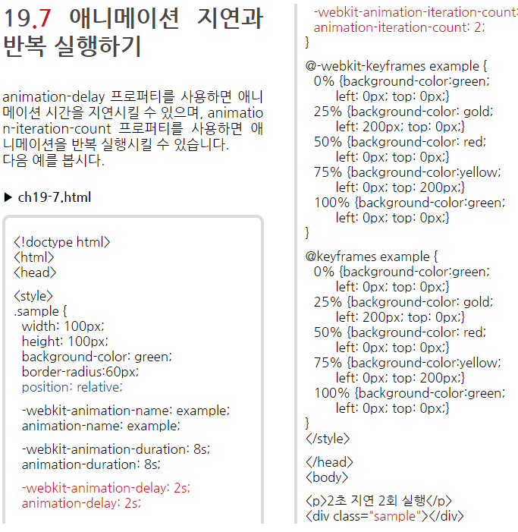
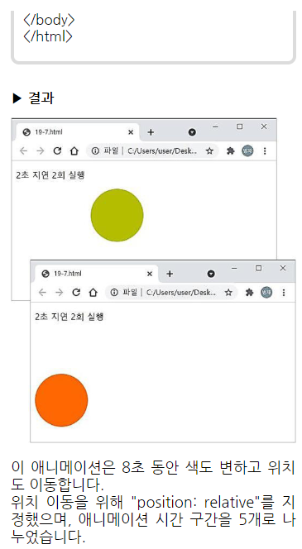

Slide 23
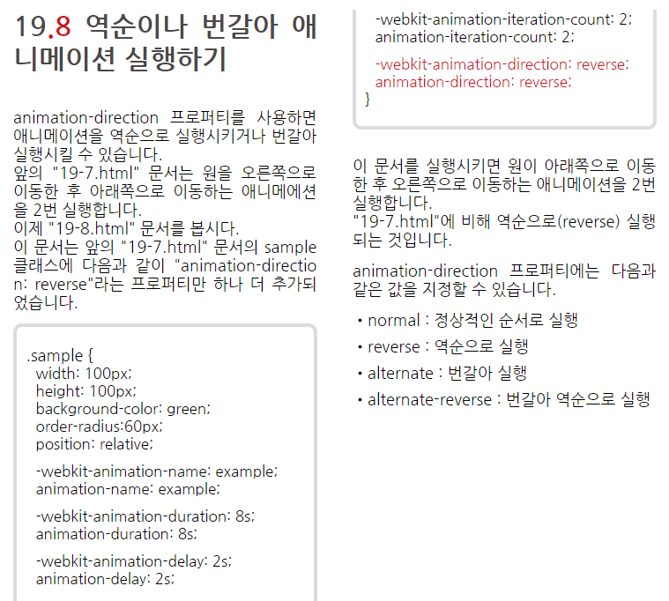

Slide 24
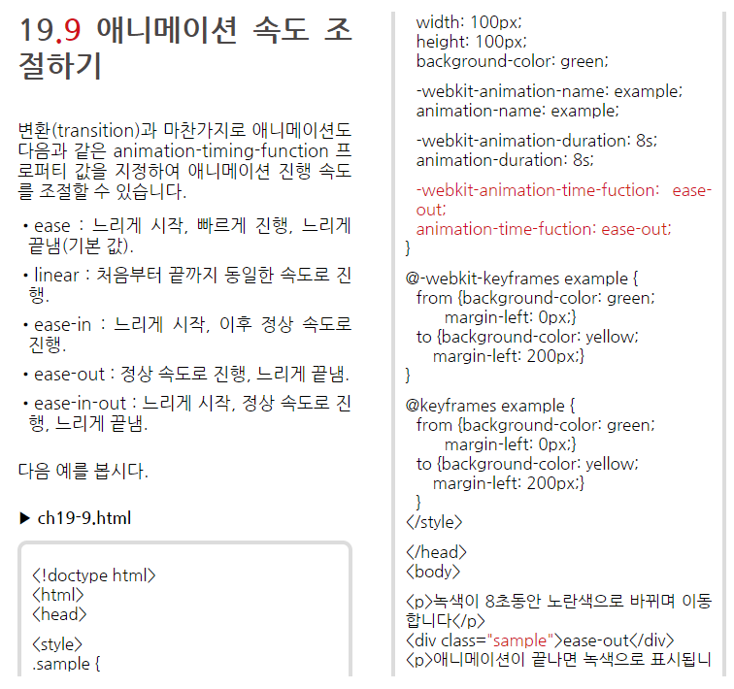
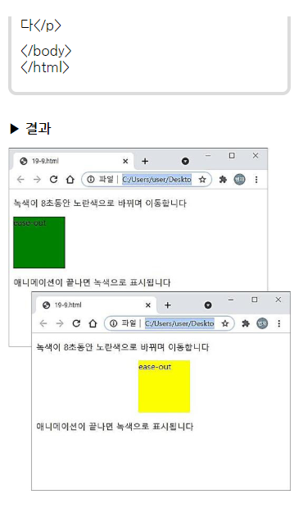

Slide 25
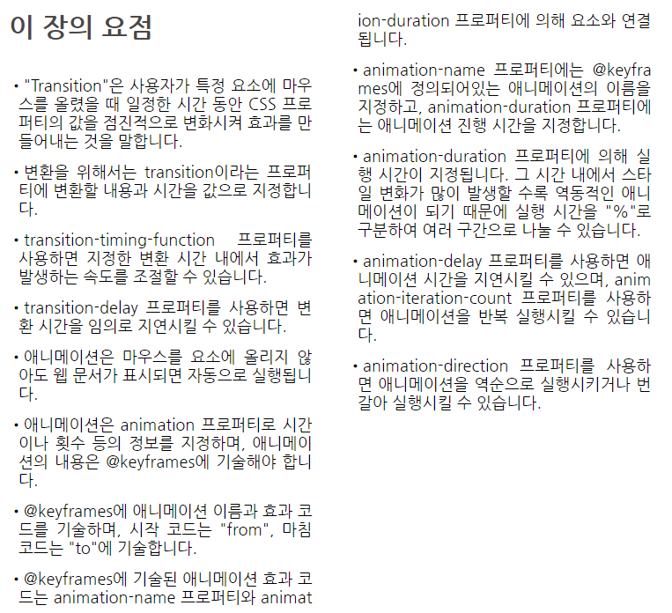

Slide 27
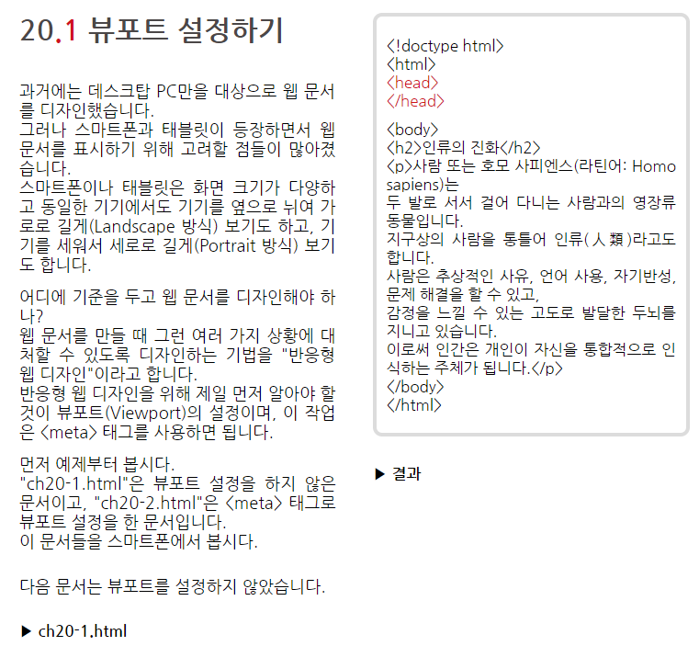

Slide 28
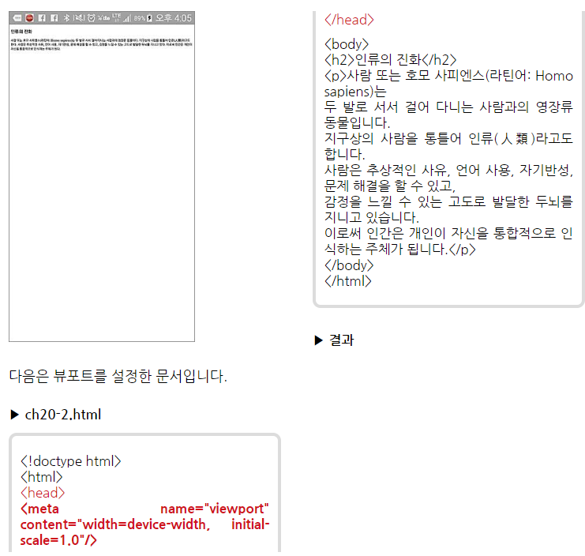
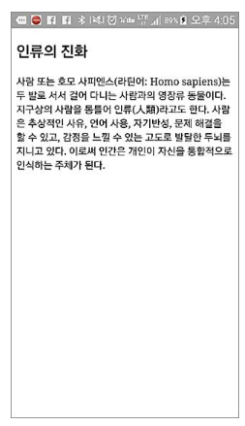

Slide 29
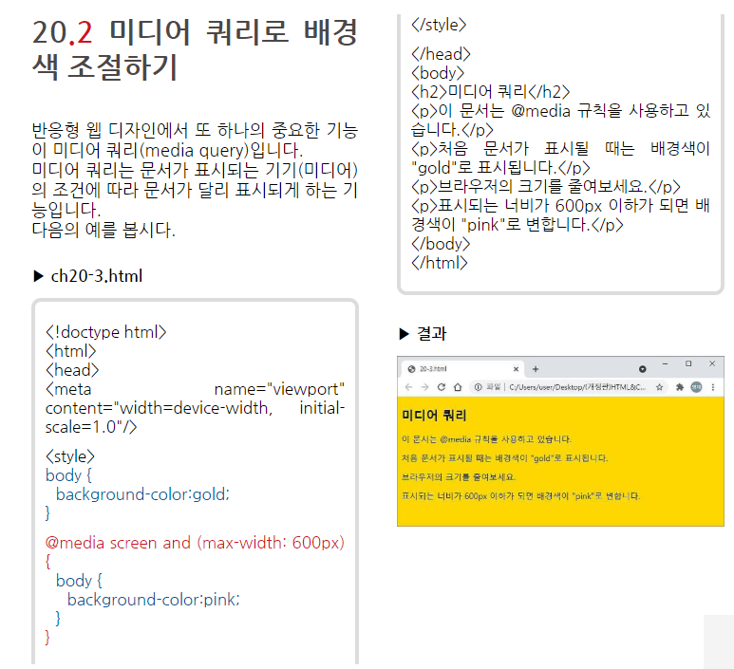

Slide 30
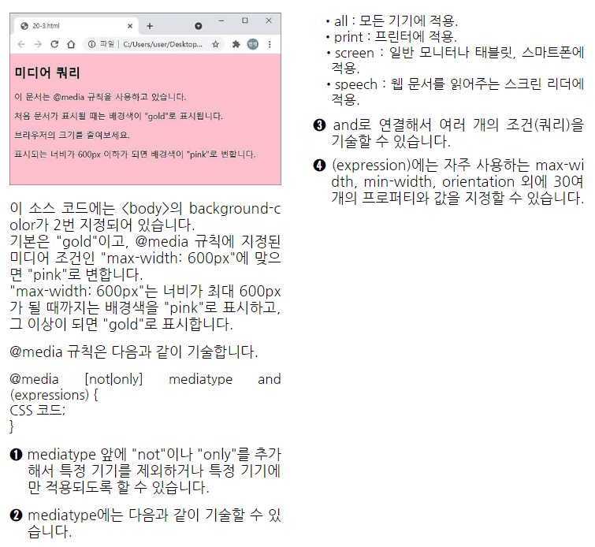

Slide 31
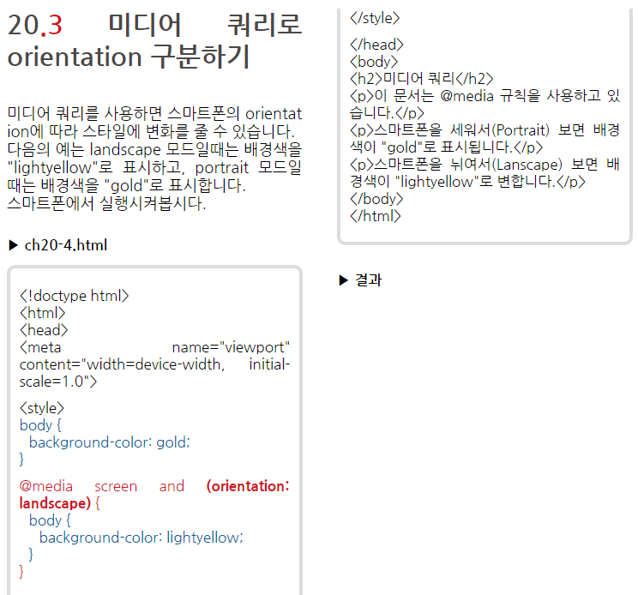
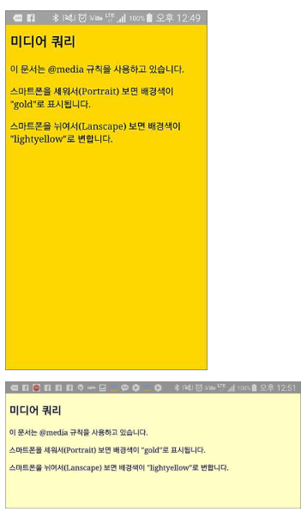

Slide 32
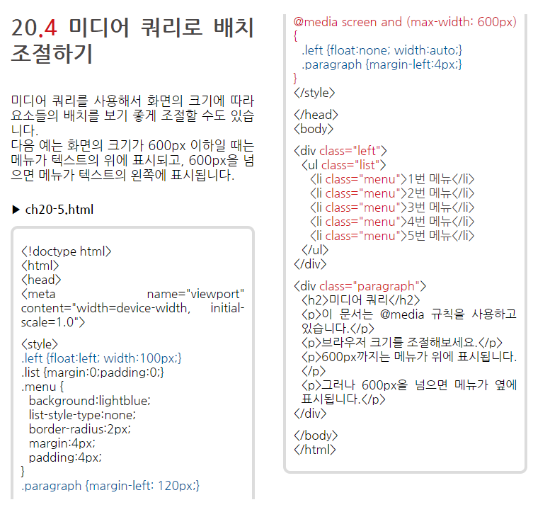
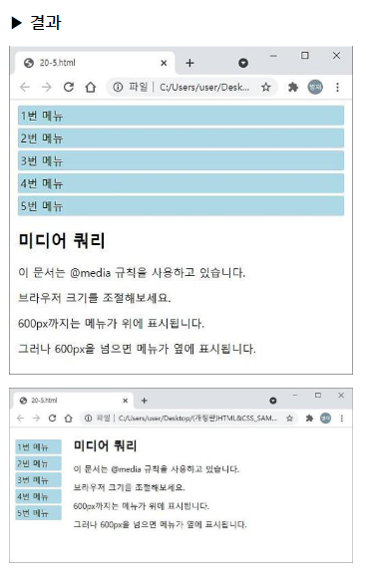

Slide 33
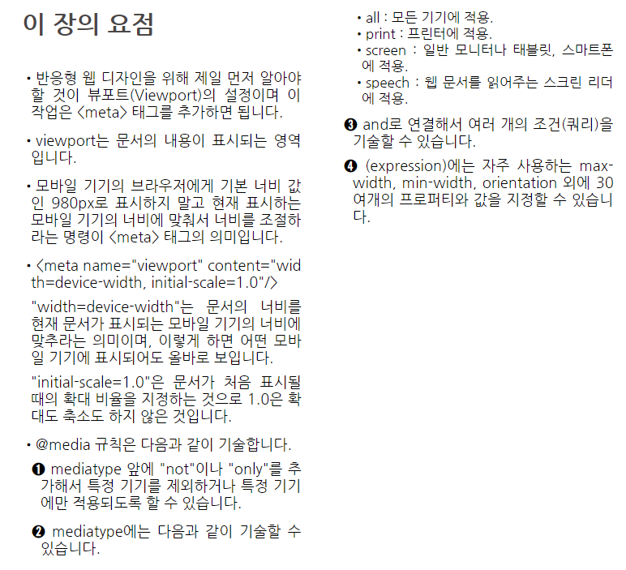

Slide 34



Slide 35


